Slide 1
Evaluating Model Performance in the Estimation of Health Effects from Complex Environmental Mixtures: A Simulation Study
Zachary Katz
April 2023

Slide 2

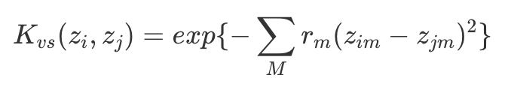
Quick Intro to BKMR
Flexible, non-parametric way to detect and estimate effects of individual exposures, groups of exposures, or an overall mixture on observed (health) effects
Can accommodate nonlinear and non-additive effects of multivariate exposure set
Models exposures through a kernel function, frequently Gaussian
Y = outcome, h = flexible function of predictors Z, X = covariate set
Kernel function shrinks estimated health effects of similar i (exposure profiles) towards each other, implicitly operating a variable selection procedure by allowing some weights to be 0
Prior information could be specified on the model parameters for Bayesian technique

Slide 3
Motivation
BKMR was originally published by Bobb & Valeri in 2015:
Generated 300 datasets of 100 observations each
Total mixture components: M = (3, 13)
One confounder
Health outcome dependent on a subset Q < M of available exposure variables, but not on a confounding covariate set
Performance unclear if confounders are included in the hinge function
As it turns out, almost all ML methods used in EHS for mixture studies have remained unchallenged in simulation studies by complex confounding structure
Lack of clarity in how methods perform in such contexts → which models to apply to the data?
Risk using sub-optimal techniques for effect estimation without proper evaluation in a controlled setting (and non-parametric techniques in particular may result in non-reproducible findings)
Objective:
Compare a variety of traditional and ML methods for evaluating individual exposure and overall mixture effects when complex relationships between exposures, confounders, and outcome are present

Slide 4
Selection of Statistical Methods
 | BKMR | BART | Quantile G-Computation | Elastic Net | Linear Regression | MARS | GAM | Causal Forest | Random Forest | Super Learner
Required
Continuous outcome | X | X | X | X | X | X | X | X | X | X
Multiple continuous exposures | X | X | X | X | X | X | X | X | X | X
Nonlinear and interaction effects on outcome | X | X | X | X | X | X | X | X | X | X
Inference (point estimates + CIs) | X | X | X | X | X | X | X | X | X | X
Automated functional form of covariates | X | X |  |  |  | X |  | X | X | X
Implementable in R | X | X | X | X | X | X | X | X | X | X
Preferred
Non- or semi-parametric | X | X |  |  |  | X | X | X | X | X
Variable selection | X | X |  | X |  | X |  |  |  | X
Popular in EHS mixture studies | X | X | X | X | X | X |  |  |  | X
Other methods evaluated: TMLE, WQS regression, LASSO, Ridge regression, BSTARSS, logistic regression, (Bayesian non-parametric) non-negative matrix factorization, (Bayesian) factor analysis, (Sparse) PLSR, Bagging, Boosting, PCA, cluster analysis, SVM, regression trees (CIT or CART)

Slide 5
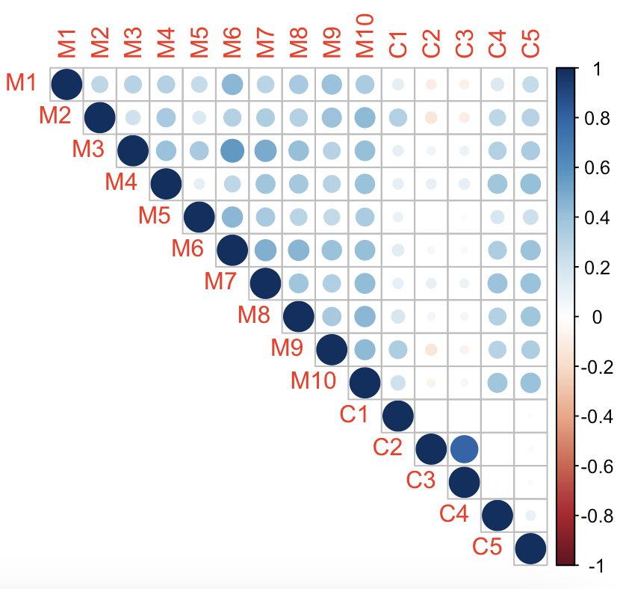
Simulation Study: Data Generation
Data generation:
2 scenarios with identical datasets except for specification of the outcome
200 datasets per scenario
10 exposures, 5 confounders, & 1 outcome
For exposures and confounders, closely mimic parameters from the Strong Heart Study (thanks Melanie!) & extend to increase dimensionality
Induce moderate multicollinearity & add noise for variation
Intra-exposure correlations generally ranging from 0.3 to 0.5
Exposure-confounder correlations vary widely, generally from -0.2 to 0.4

Slide 6
Simulation Study: Scenarios
Scenario #1:
Simple exposures (M1-M5 only)
Complex confounding (C1-C5)
Moderate multicollinearity
Scenario #2:
Confounders specified identically to Scenario #1
Only change is in how exposure set is specified in outcome’s functional form
Additional exposure-confounder interaction

Slide 7


Estimand of Interest
Two primary effects of interest:
Individual mixture component on continuous outcome Y
Complete mixture on continuous outcome Y
Causal estimand = change in mean of outcome Y when the exposure changes from one value to another (static; fixed intervention)
For individual mixture components:
For complete mixture:

Slide 8
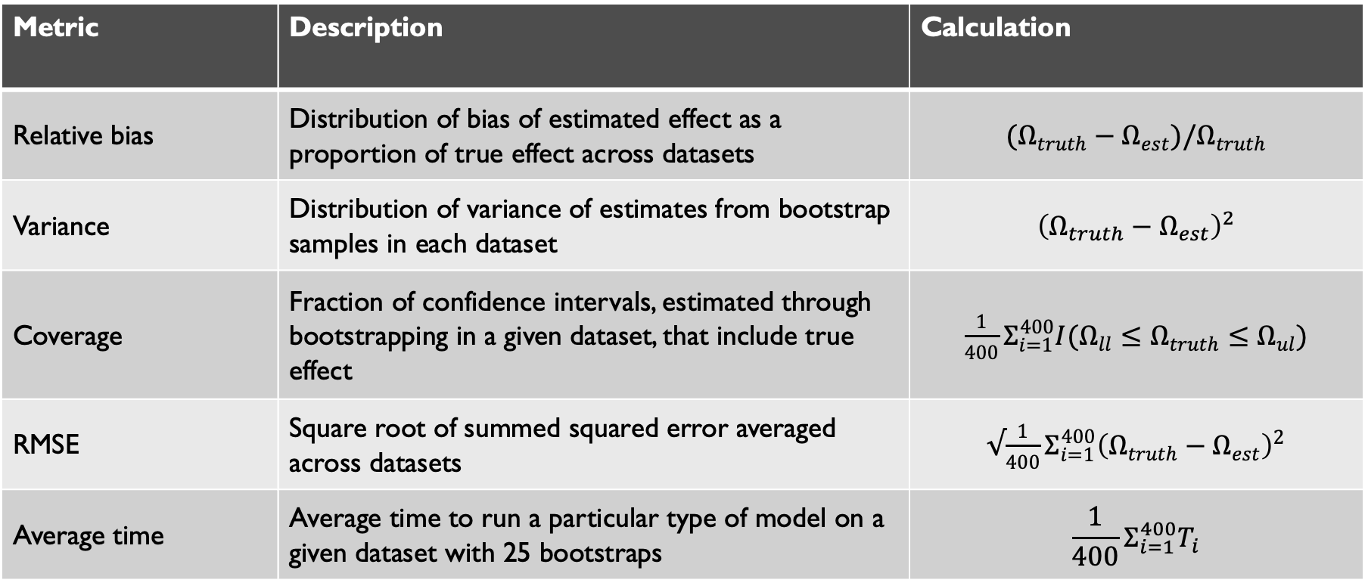
Primary Performance Metrics
Metric | Description | Calculation
Relative bias | Distribution of bias of estimated effect as a proportion of true effect across datasets | $$(Ω_{truth}−Ω_{est})/Ω_{truth}$$
Variance | Distribution of variance of estimates from bootstrap samples in each dataset | $${\left(Ω_{truth}−Ω_{est}\right)}^{2}$$
Coverage | Fraction of confidence intervals, estimated through bootstrapping in a given dataset, that include true effect | $\frac{1}{400}Σ_{i=1}^{400}I(Ω_{ll}≤Ω_{truth}≤Ω_{ul})$
RMSE | Square root of summed squared error averaged across datasets | $√\frac{1}{400}Σ_{i=1}^{400}{\left(Ω_{truth}−Ω_{est}\right)}^{2}$
Average time | Average time to run a particular type of model on a given dataset with 25 bootstraps | $$\frac{1}{400}Σ_{i=1}^{400}T_{i}$$

Slide 9
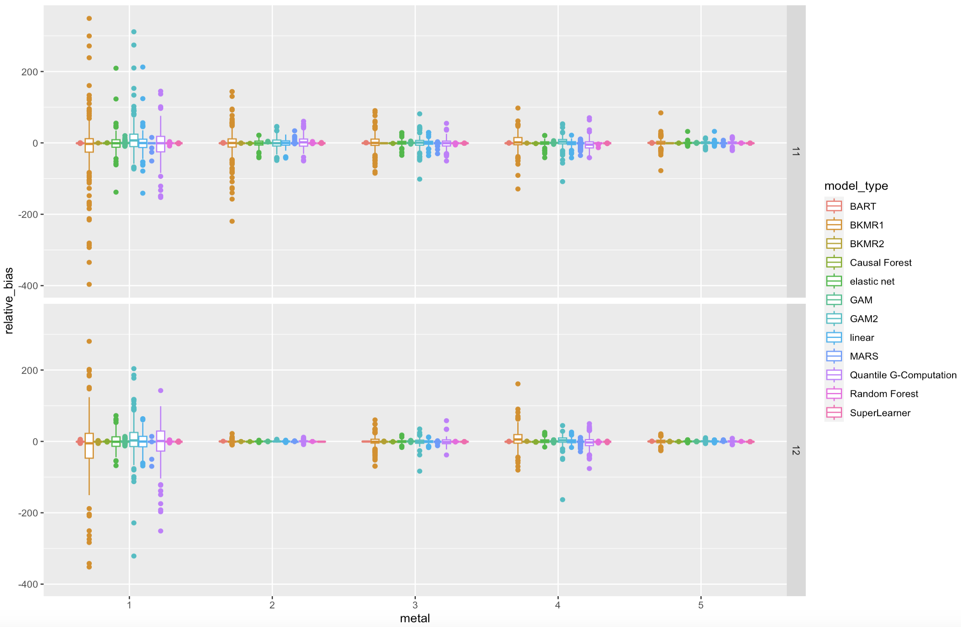
Ex. Relative Bias Comparison (Individual Metals)

Slide 10
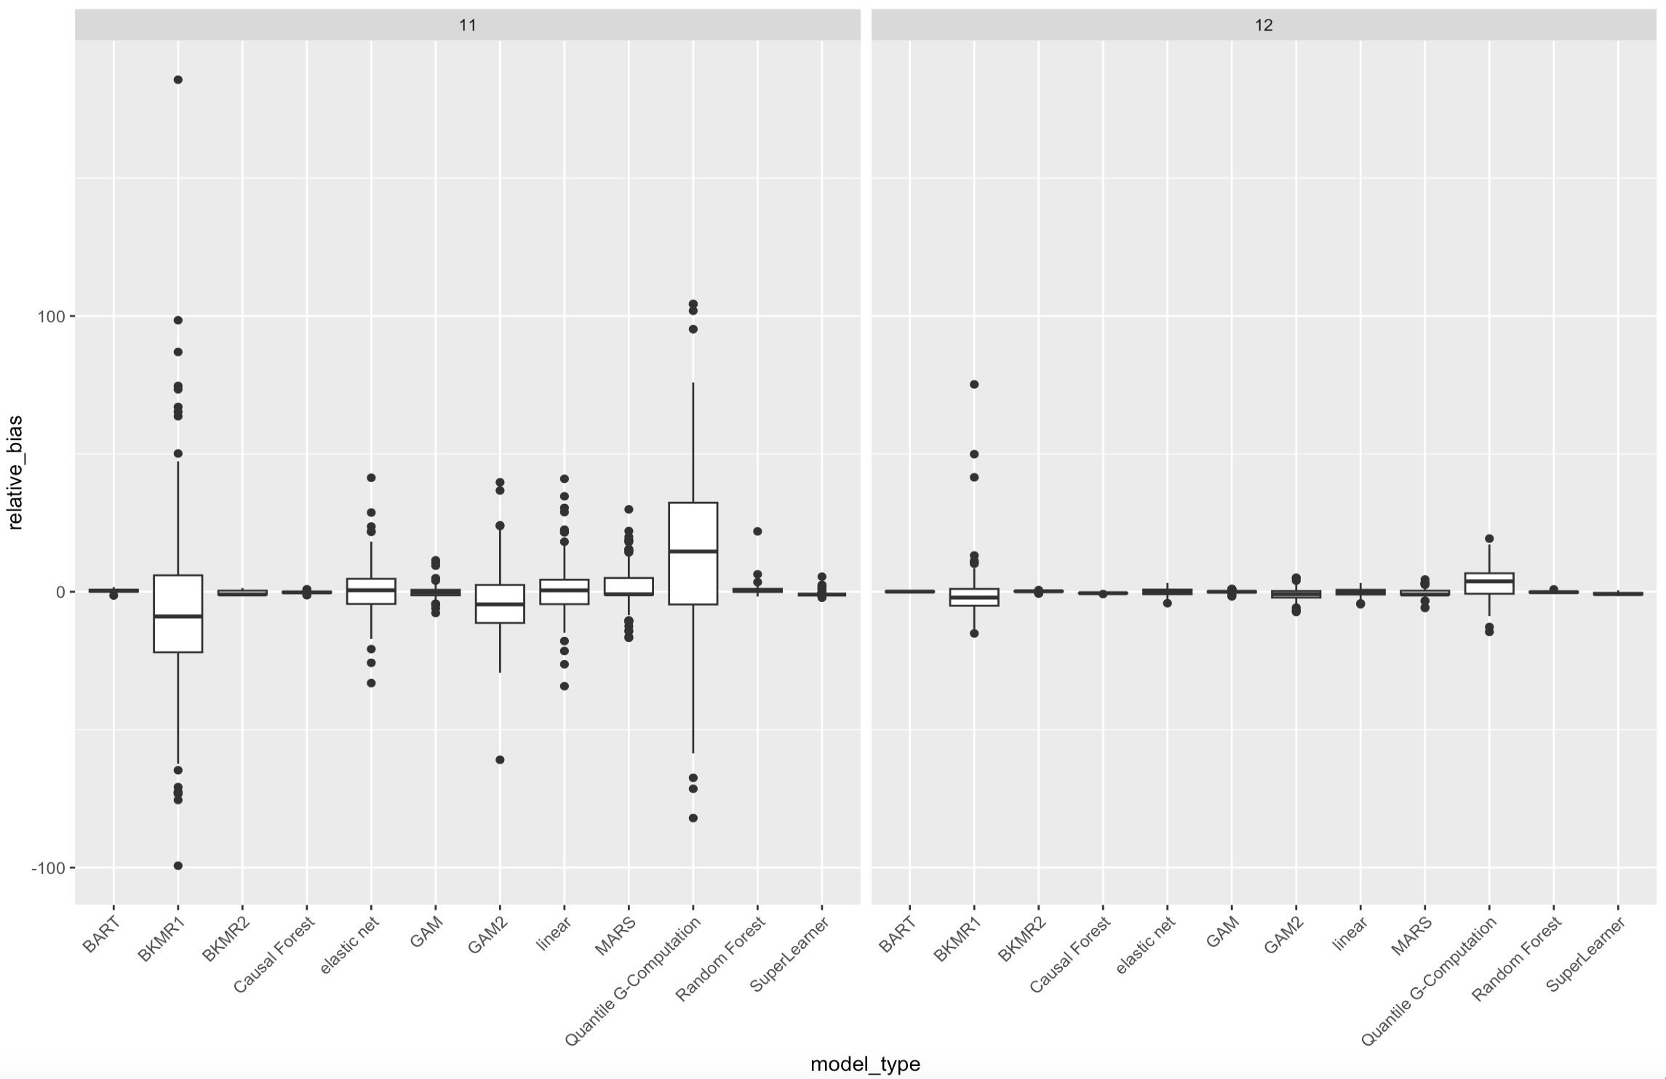
Ex. Relative Bias Comparison (Metal Mixture)

Slide 11
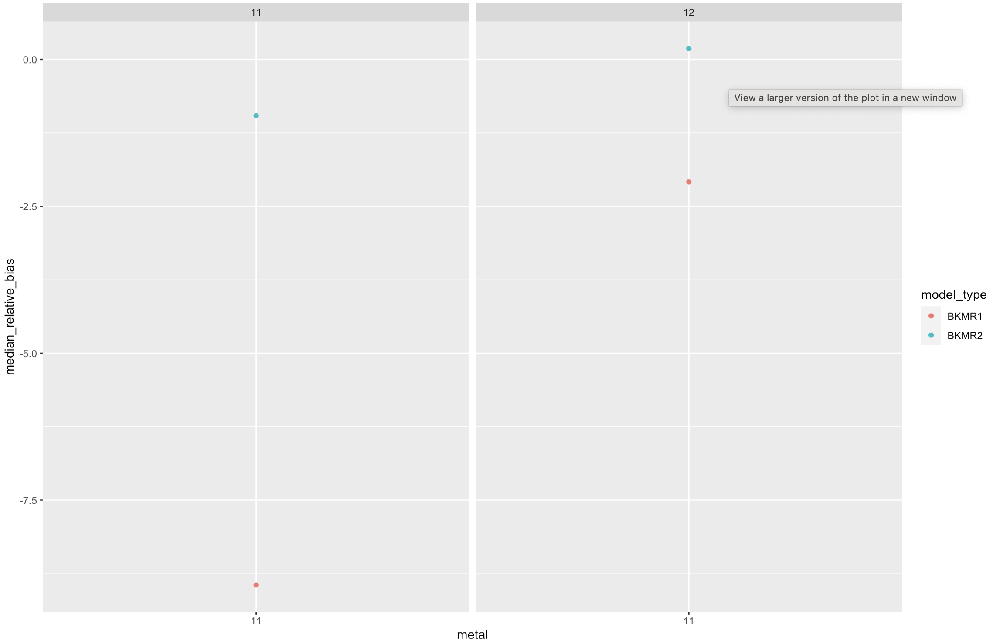
Ex. Metal Mixture: BKMR1 vs. BKMR2)

Slide 12
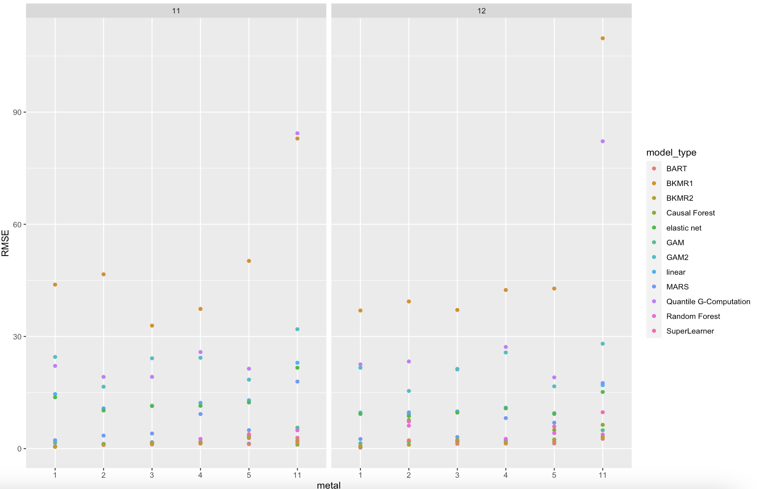
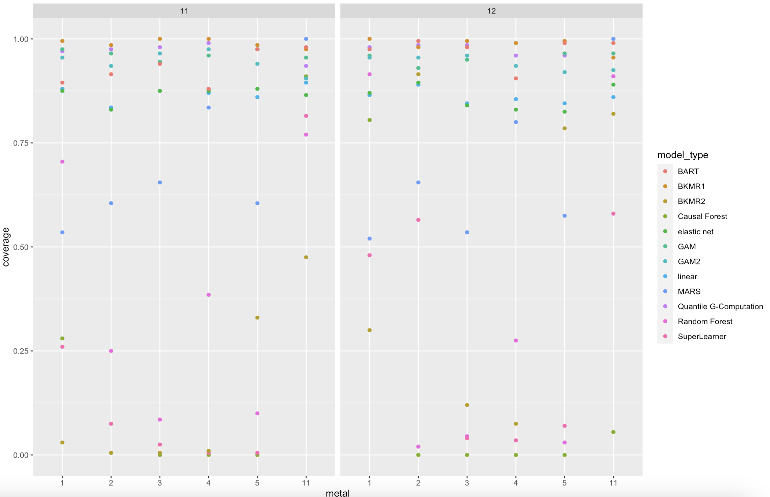
Other Metric Examples
RMSE
Coverage

Slide 13
The Best and the Worst (Examples): Relative Bias
 | Best (Mean) | Worst (Mean) | Mean | Median
Scenario 11, Metal 1 | GAM (.05) | GAM2 | -0.9 | -0.958
Scenario 11, Metal 2 | Linear (.15) | Quantile G-Comp | -0.561 | -0.857
Scenario 11, Metal 3 | GAM2 (.03) | Quantile G-Comp | -0.535 | -0.824
Scenario 11, Metal 4 | GAM (.08) | Quantile G-Comp | -0.696 | -1.01
Scenario 11, Metal 5 | BART (.01) | Super Learner | -0.242 | -0.0143
Scenario 11, Metal Mix | GAM (.12) | Quantile G-Comp | 0.348 | 0.0762
Scenario 12, Metal 1 | GAM (.00) | BKMR1 | -1.59 | -0.644
Scenario 12, Metal 2 | BKMR2 (.02) | MARS | -0.239 | -0.0654
Scenario 12, Metal 3 | GAM (.02) | GAM2 | -0.765 | -0.904
Scenario 12, Metal 4 | GAM (.04) | BKMR1 | -0.141 | -0.885
Scenario 12, Metal 5 | Elastic Net (.00) | Super Learner | -0.315 | -0.119
Scenario 12, Metal Mix | GAM (.00) | Quantile G-Comp | -0.0322 | -0.121

Slide 14
Comparing Models
Simple Exposures, Complex Confounding:
Relative Bias
Best: GAM1, Linear
Worst: GAM2, QGComp
RMSE:
Best: BART, Causal Forest
Worst: GAM2, QGComp, BKMR1
Coverage:
Best: BKMR1, GAM1, QGComp
Worst: BKMR2, Causal Forest, Super Learner
Complex Exposures, Complex Confounding:
Relative Bias
Best: GAM1, Linear, BART
Worst: GAM2, QGComp, BKMR1
RMSE:
Best: BART, BKMR2
Worst: GAM2, QGComp, BKMR1
Coverage:
Best: BKMR1, BART, QGComp
Worst: Causal Forest, Super Learner
BART may provide the best balance re: bias/variance tradeoff in cases with simple exposure profile,
whereas BKMR (w/ confounders specified in kernel function) may do the same in cases with complex exposure profiles…
HOWEVER: ultimately, no single method consistently and accurately controls for confounding in these settings

Slide 15
Model Ensembles
Question: If our advice is to use multiple models to triangulate upon point estimates for individual metal and mixture effects, which methods minimize relative bias?
Methods attempted:
Model averaging
Mean / median across model means / medians (across datasets)
Model weighting
Weight by individual model distance from inter-model mean / median, for each metal
Weight by individual model distance from inter-model mean / median, summed over metals
Model weighting with subsetting
Same as above, but restrict to top 3 or 5 models on the above metric
Same as above, but restrict to some tolerance (e.g. 0.5 or 1 SD) on the above metric
Overall, incorporating the “wisdom of crowds” through sheer model averaging provides estimates with sufficiently low (or, in some cases, lower) bias compared to weighting methods – but still more biased than the best individual models

Slide 16
Future Work & Extensions
Stochastic interventions (e.g. new estimand based on shift in metal distribution using MCMC)
Dose-response curves / PDPs & related measures
Additional scenarios (e.g. vary collinearity, metal skewness, functional form complexity, metal-confounder relationships, etc.)
Simulations with more datasets and more bootstrapping (e.g. 400-500 datasets, 100 bootstraps per dataset…but cluster was quite unstable – thanks for troubleshooting, @Zilan!)
Vary model hyperparameters and variable selection methods (e.g. hierarchical)
Additional models (e.g. CVtreeMLE?)
Further work on ensembles (e.g. Bayesian model averaging, checking on validation sets)
Test findings on real-world data (e.g. Strong Heart Study)

